Slide 1
UX and AI
Based on: https://radix.ai/blog/2021/3/how-to-design-a-user-experience-that-creates-trust-and-collaboration/

Slide 2
3 complexities of AI
Learning nature of AI
We need to be able to give feedback
People are not good at understanding predictions
Automation bias
Increasing Accuracy
Calibrate user trust

Slide 3
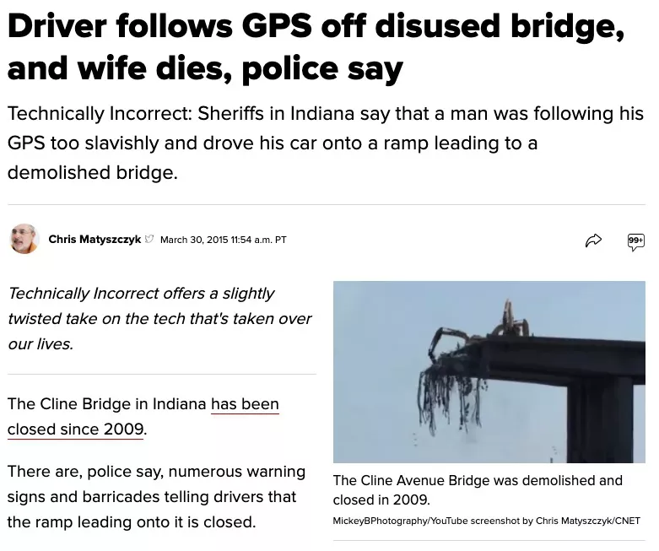

Slide 4
How to design your solution?

Slide 5
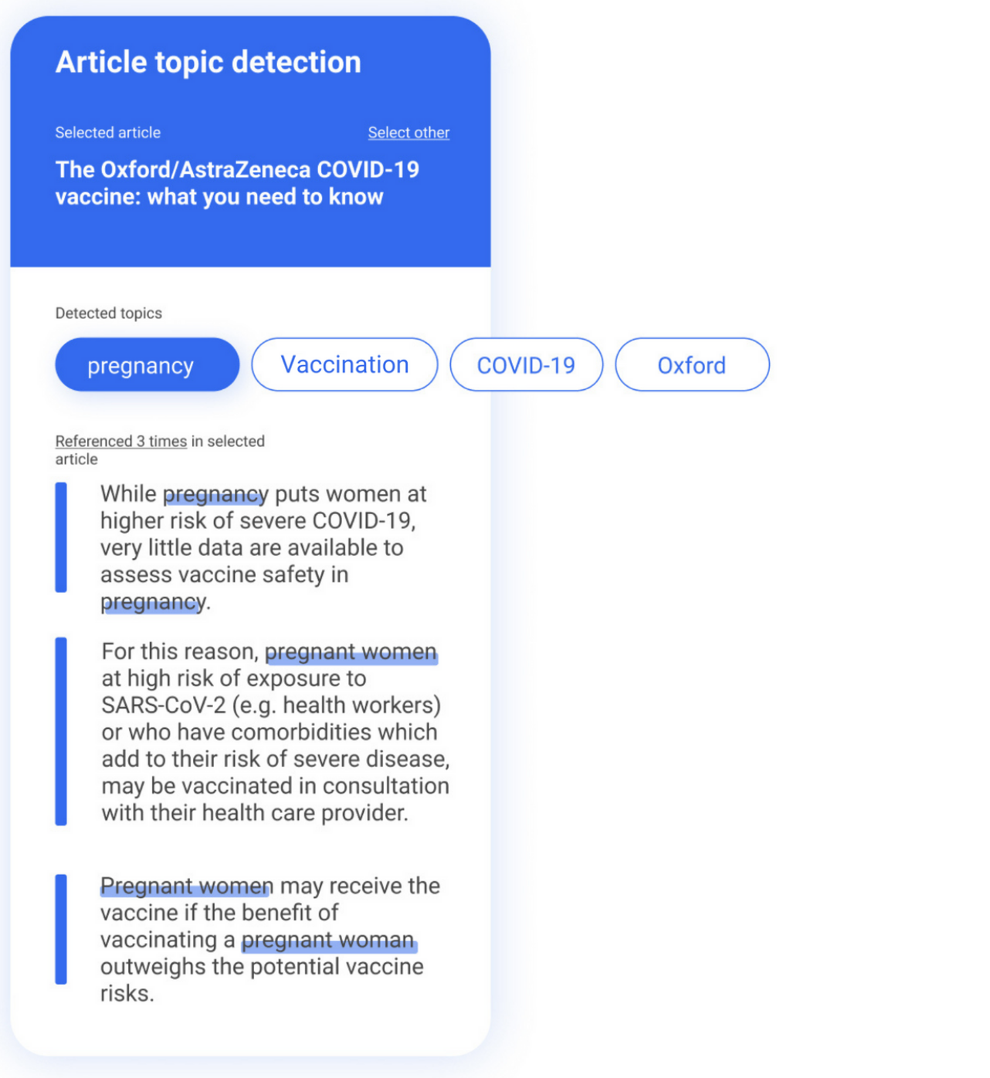
Give understanding of why a certain prediction was made

Slide 6
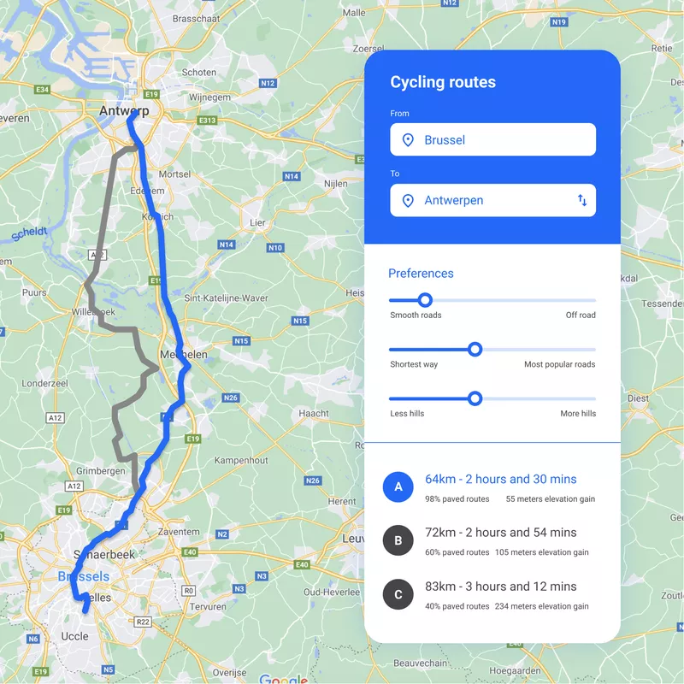
Simulate predictions

Slide 7
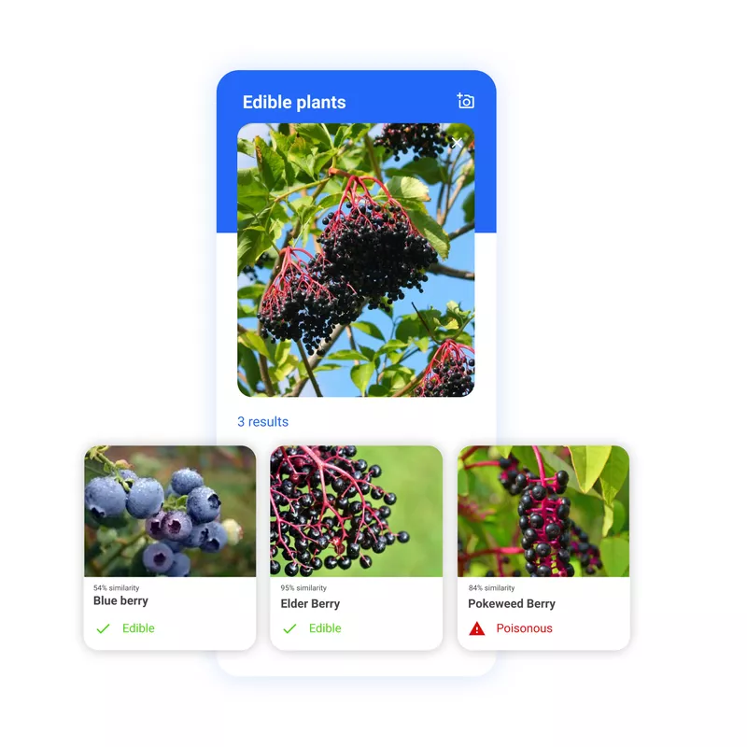
Two minds

Slide 8
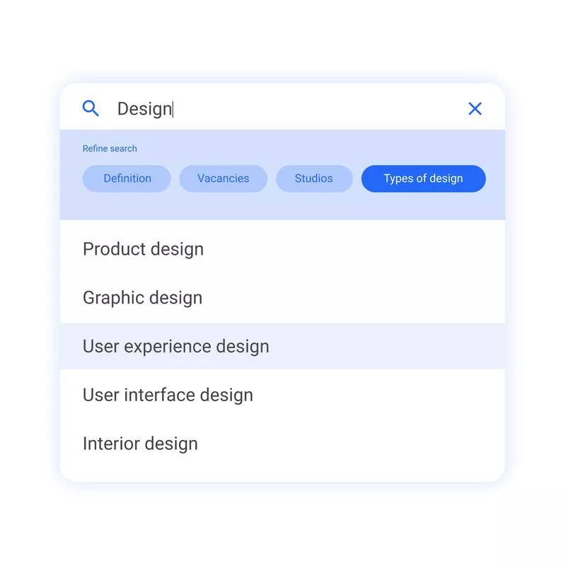
options

Slide 9
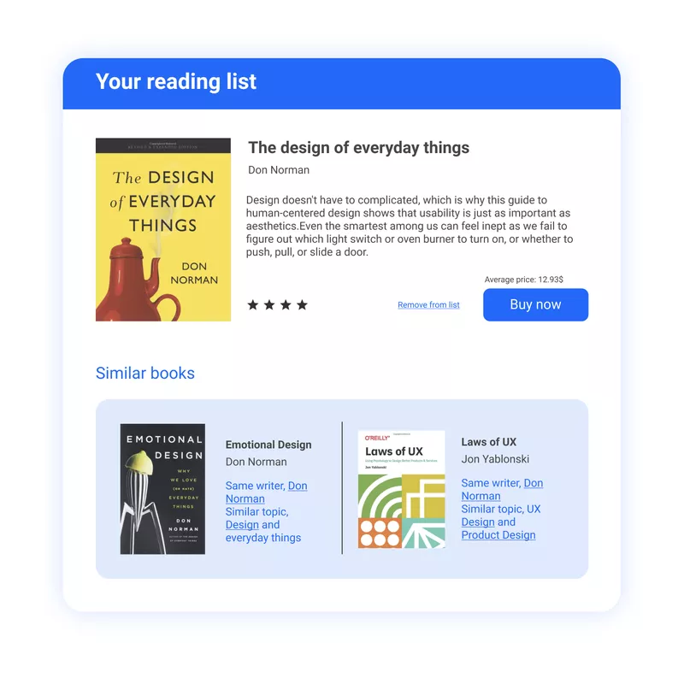
Nearest Neighbours

